Slide 1
Maths
Unit 4 – Addition and Subtraction
WALT:
6Ni.01 – Estimate, add and subtract integers.

Slide 2



WALT: Estimate, add and subtract integers.
With support, I can estimate, add and subtract integers.
Independently, I can estimate, add and subtract integers.
I can make predictions during an investigation.

Slide 3
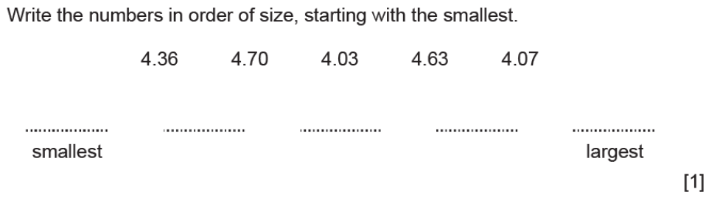
WALT: Estimate, add and subtract integers.
Retrieval Practice

Slide 4
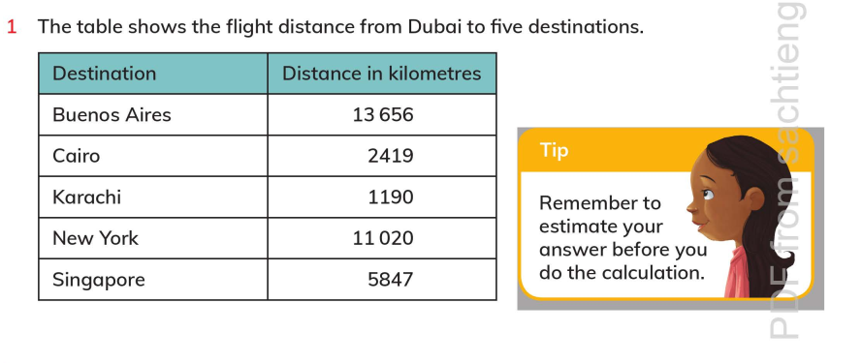
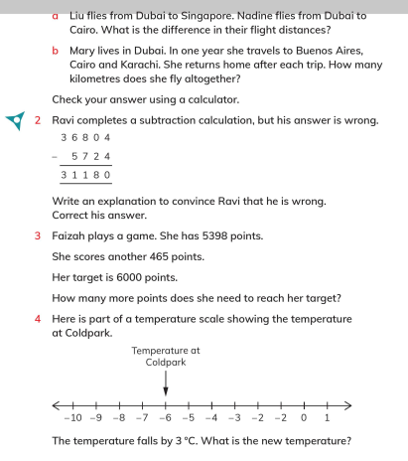
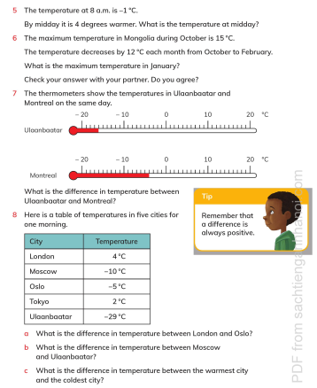
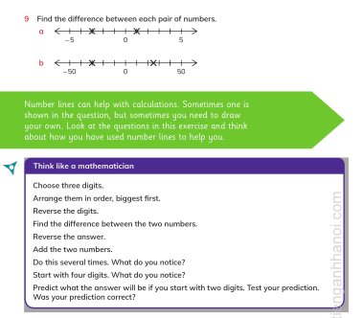
Page 50 - 53
WALT: Estimate, add and subtract integers.

Slide 5
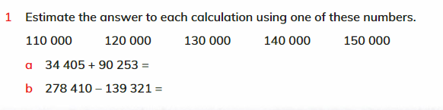
WALT: Estimate, add and subtract integers.
120,000
140,000

Slide 6
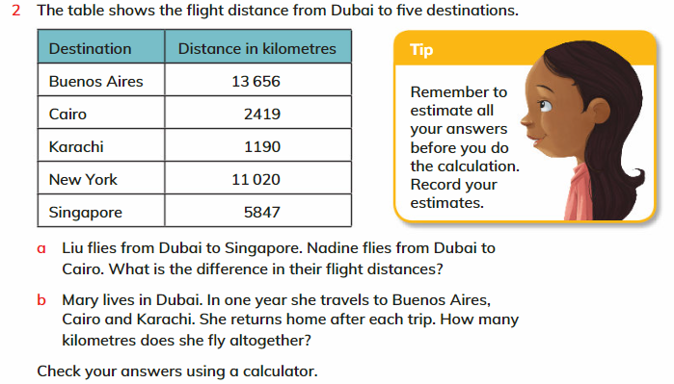
WALT: Estimate, add and subtract integers.
3,428
17,265

Slide 7
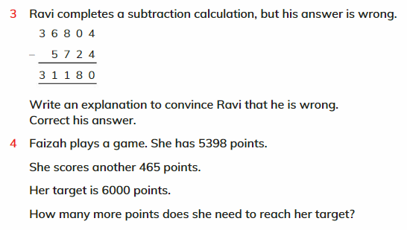
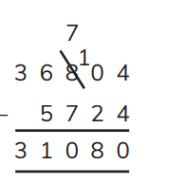
WALT: Estimate, add and subtract integers.
137 points

Slide 8
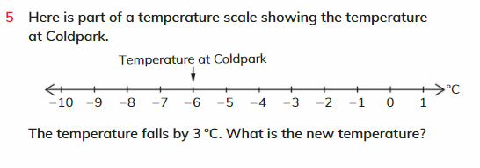
WALT: Estimate, add and subtract integers.
-9°C

Slide 9
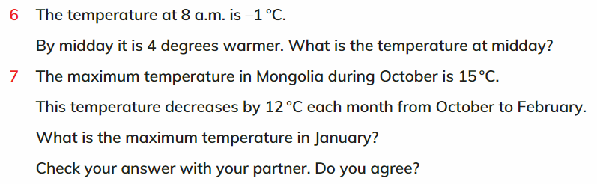
WALT: Estimate, add and subtract integers.
3°C
-21°C

Slide 10
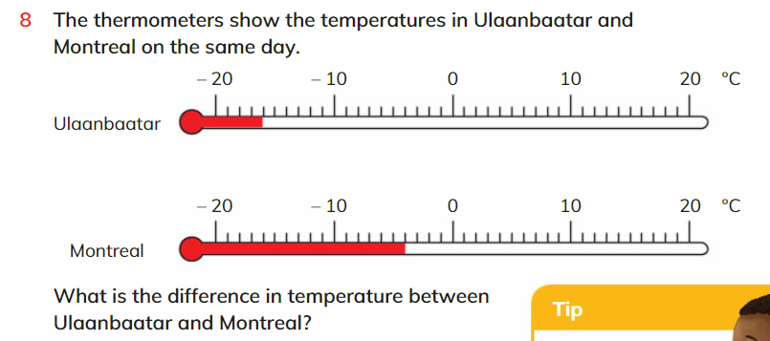
WALT: Estimate, add and subtract integers.
12°C

Slide 11
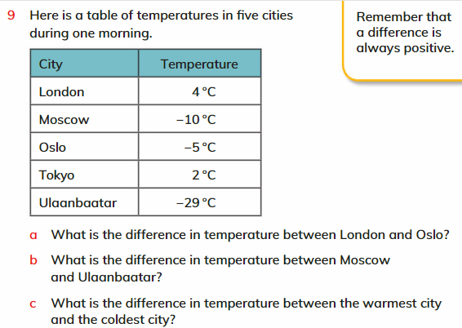
WALT: Estimate, add and subtract integers.
9°C
19°C
33°C

Slide 12
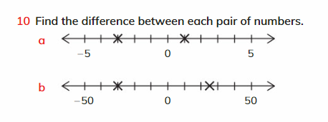
WALT: Estimate, add and subtract integers.
4
55

Slide 13
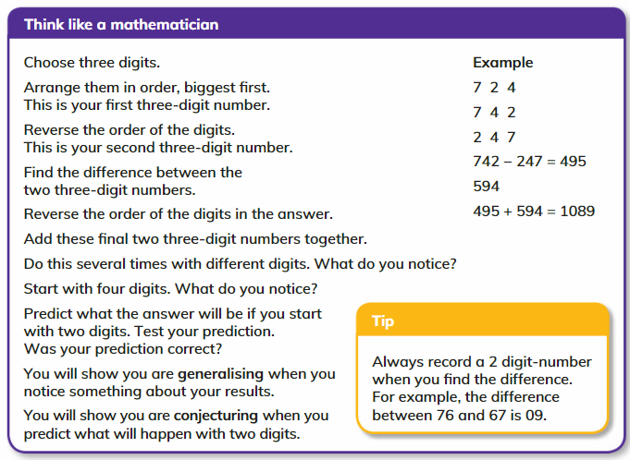
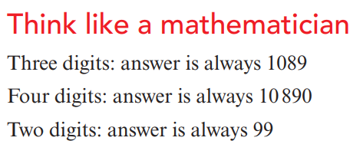
WALT: Estimate, add and subtract integers.

Slide 14
WALT: Estimate, add and subtract integers.
With support, I can estimate, add and subtract integers.
Independently, I can estimate, add and subtract integers.
I can make predictions during an investigation.

